Slide 1
qFIT Analysis at MTW
By Dave Parris
Senior BMS Maidstone Clinical Chemistry

Slide 2
What is qFIT
Quantitative Faecal Immunochemical Test detection of human haemoglobin (blood) in stool samples.
Replaced Guaiac FOBT (unreliable tests)
Used as a screening tool in helping diagnosing bowel cancer (is not a diagnostic test)
Bowel cancer 4th most common cancer in UK with 2nd highest rate of mortality for cancer
Colonoscopy gold standard diagnosing cases but service over-run and procedure costly and with morbidity/mortality risks
qFIT can help ensure patients that need colonoscopy get one

Slide 3
NICE Guidelines
NG12 2015 Suspected cancer: recognition and referral
Lower GI Tract cancers 2WW referral recommendations:
>40y/o unexplained weight loss with abdo pain
>50y/o with rectal bleeding
>60 y/o with IDA/CIBH/Test show occult blood in stool
Rectal/abdominal mass
<50y/o rectal bleeding with unexplained abdo pain/CIBH/WL/IDA
DG30 2017 adoption of qFIT in primary care to guide referral for suspected colorectal cancer in people without rectal bleeding who have unexplained symptoms but do not meet the criteria in NG12
4% PPV Bowel cancer symptoms alone

Slide 4
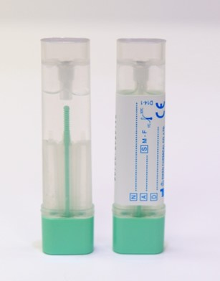
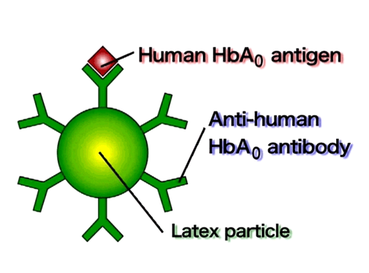
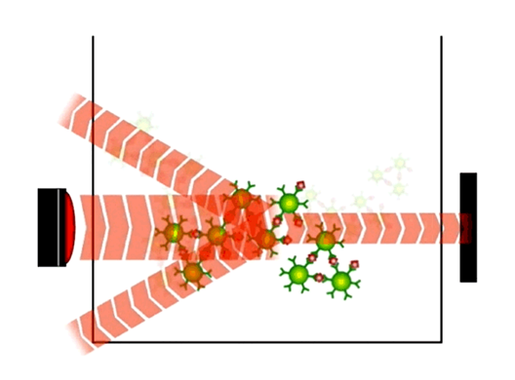
qFIT Test Principle
Patient collects small part of faecal sample in sample collection tube
Latex agglutination reaction
Sample is collected by probe and dispensed in reaction cell along with latex reagent
Latex particles are used which are paired with specific polyclonal antibodies against human haemoglobin (anti-human-HbA0)
These form specific bonds with the haemoglobin from the stool sample and there follows an agglutination of latex particles
After incubation the reaction cell is photometrically analysed
The change in absorbance per time unit resulting from the latex agglutination reaction is proportional to the concentration of haemoglobin in the sample.

Slide 5
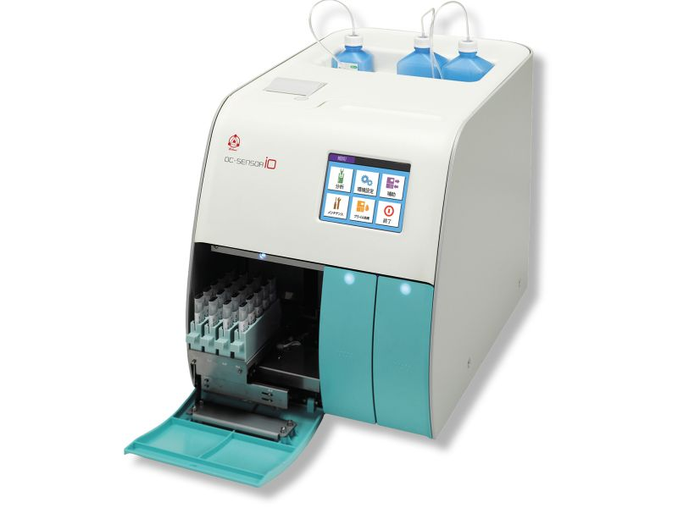
Introduction of qFIT to MTW
National Bowel Cancer Screening service ages 60 – 74 (2019)
April 2020 introduced qFIT to help triage colonoscopy during COVID pandemic for MTW
OC Sensor iO
Analytical range 4 – 200 µg Hb/g stool
May 2020 qFIT Kent & Medway
September 2020 low risk GP pilot
January 2021 introduced for all GP as low risk request

Slide 6
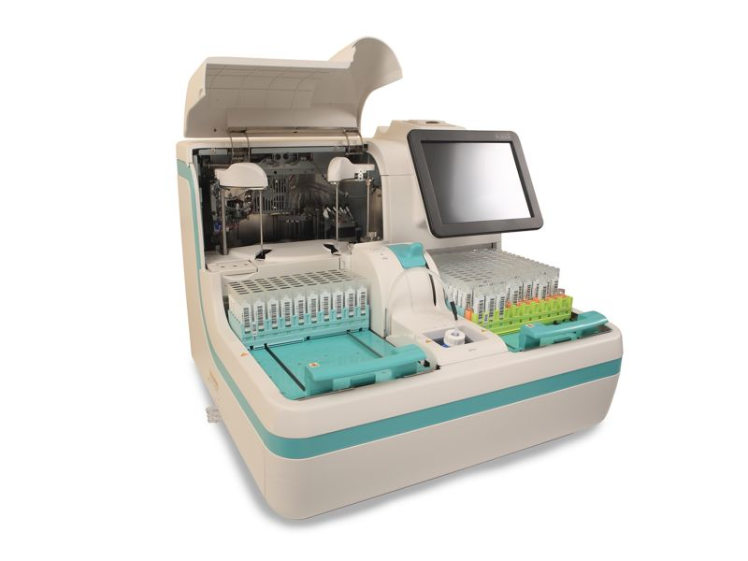
Development of service
Oct 2021 WK GP request qFIT for high risk at time of 2WW referral
Feb 2022 introduction of OC Sensor Pledia
Analytical Range 2-200 µg Hb/g stool
NPEx reporting for other trusts
Jan 2021 1000 tests per month
Oct 2022 5000 tests per month
K&M wide GP requesting of qFIT & review of results before making 2WW referral

Slide 7
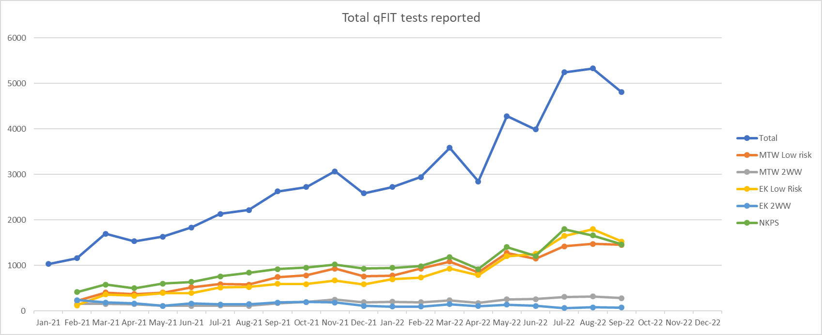
qFIT Monthly Workload

Slide 8
Result Interpretation
<10 µg Hb/g Negative (no referral/discharged/safety netting if symptoms persist)
≥10 µg Hb/g Positive (Referral 2WW/Colonoscopy/Imaging)
<10 µg Hb/g NPV 99.6%
≥10 – 150 µg Hb/g : PPV 6% cancer
>150 µg Hb/g : PPV 31% cancer
12-20% MTW referrals discharged from 2WW due to <4 µg Hb/g result
<2 µg Hb/g sensitivity for CRC equivalent to colonoscopy (97%)
National bowel cancer screening service uses cut off of >120

Slide 9
Case Study - qFIT
63 y/o female attended GP January 10th 2022 with abdominal pain
General chemistry & Haem unremarkable with negative coeliac screen
Returned to GP on 22nd April still with LLQ discomfort
Ca125 requested: result 12 U/mL (<35)
qFIT also requested. Sample returned to lab on 28th April and reported 29th April
qFIT result was >200 µg Hb/g stool

Slide 10
Case Study - Diagnosis
3.5.22 GP made a 2WW referral to Colorectal Team and patient was seen 5.5.22
Patient underwent colonoscopy on 9.5.22
Found to have malignant looking mass in the sigmoid of colon
Histopathology reported: ‘fragments of large bowel mucosa with a locally arising moderately differentiated adenocarcinoma’
11.5.22 Ultra sound of pelvis normal
CT scan 13.5.22 showed also 53mm diameter liver metastasis in segment VI liver

Slide 11
Case Study - Treatment
Primary diagnosis of C18.7 Sigmoid colon T3 N0 M1 on 30.5.22
32 days from reported qFIT result to diagnosis
MRI 9.6.22 showed 4 liver mets (3 segment V/VI and one in segment VII)
Commenced neo-adjuvant CAPOX 30.6.22
CT 22.9.22 Showed main Liver met reduced from 53mm to 26mm, small lesions in segments V & VI not visible with no extra malignancy
Good partial response to treatment
Flexi Sig 13.10.22 showed primary still present but smaller than initial colonoscopy
Surgery planned for resection of colon and liver surgery

Slide 12
Case Study – Continued Involvement
CEA monitoring: initial result 10 µg/L (<5)/18.9.22 result 4 µg/L
DPYD gene testing: Patient had no mutations
Continued Renal/LFT/FBC measurements before surgery/chemo
Patient would not have got on the 2WW Pathway with out the low risk qFIT result (no weight loss/CIBH/IDA/Rectal Bleeding/abdo mass)
Diagnosis may have taken longer and prognosis could have been worse

